Slide 1
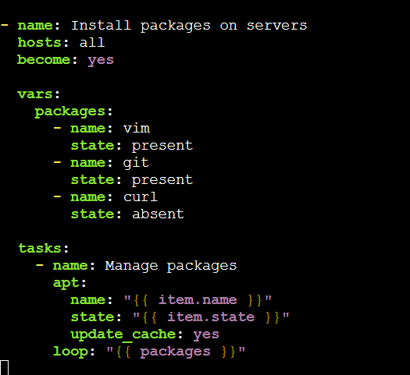
Yaml code to install the packages
- name: Install packages on servers
hosts: all
become: yes
vars:
packages:
- name: vim
state: present
- name: git
state: present
- name: curl
state: absent
tasks:
- name: Manage packages
apt:
name: "{{ item.name }}"
state: "{{ item.state }}"
update_cache: yes
loop: "{{ packages }}"

Slide 2
